Slide 1

Sales performance analysis
Butterfly Sharp Shooters
Gazelle B, Elfie H, John N, Venessa Y

Slide 2
Core Message: Hurley’s 2016 and 2017 sales performance
Identify the most popular categories based on quantity sold – pie chart
Identify the highest margin categories to focus on producing for the upcoming holiday season – bar graph
Sales performance by store locations – bar graph
Whether or not to reduce the promotions in order to drive higher gross margin
Quantity sold in men’s and women’s over the past 3 years– line graph
The relationship between gross margin rate vs. gross margin dollars

Slide 3
Hypotheses
T-shirts, swimwear might be the most popular items
T-shirts, swimwear might have the highest margin
Too much promotion may result less profit
Women’s may have higher sales quantity than men’s

Slide 4
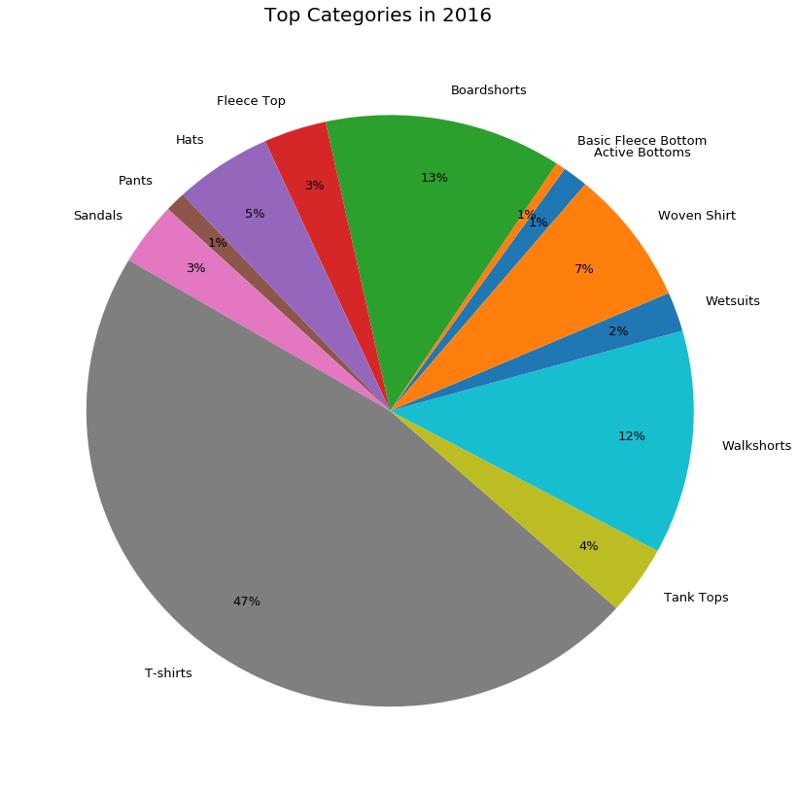
Most Popular Categories in 2016

Slide 5
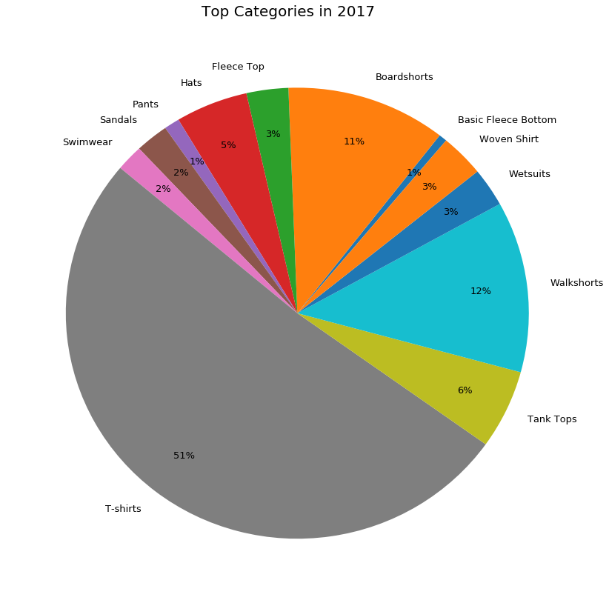
Most Popular Categories in 2017

Slide 6
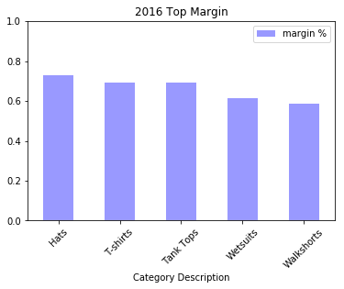
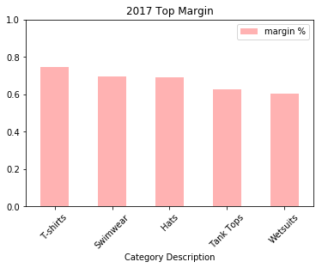
Top Margin Categories

Slide 7
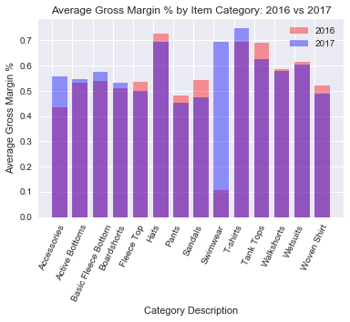
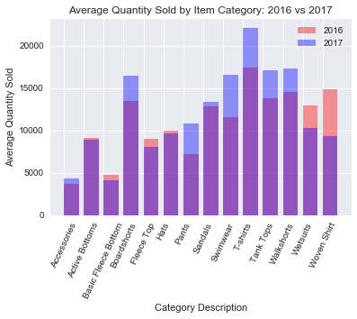
Margins vs Quantity

Slide 8
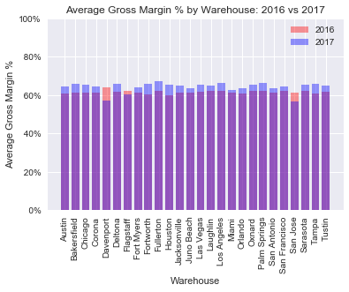
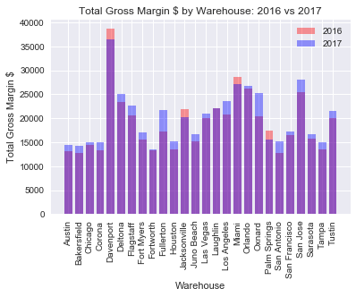
Location vs. Margin
Davenport and San Jose stores have the highest gross margins in dollars
But their gross margin rate has reduced from 2016 to 2017
Notes:
Sales quantity increased across many categories in 2017
Accessories fairly same units sold but gross margin rate grew significantly in 2017
Sandals and tank-tops sold more units but decreased in gross margin rate in 2017

Slide 9
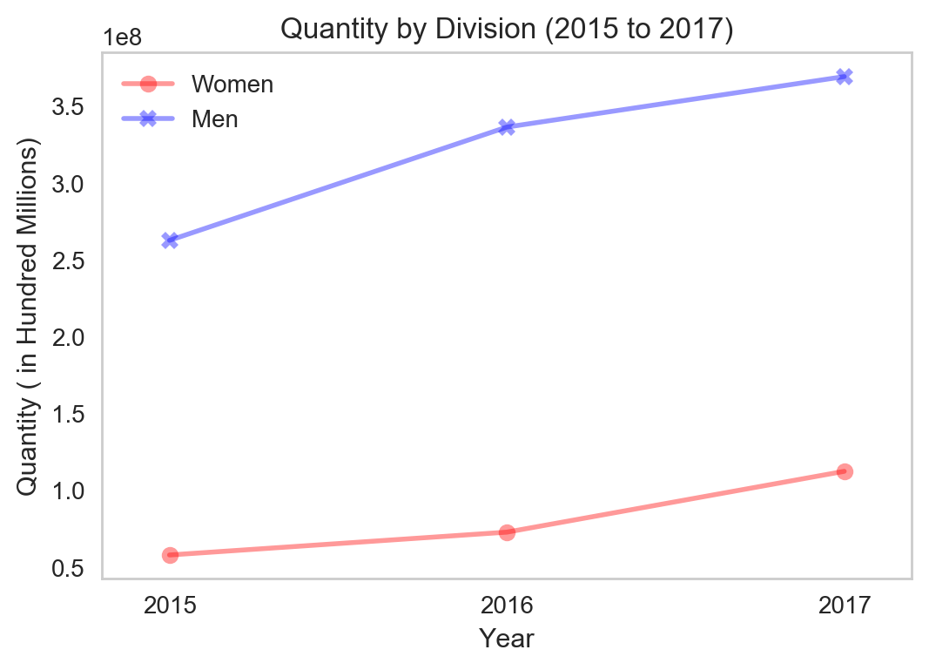
Division vs. Quantity

Slide 10
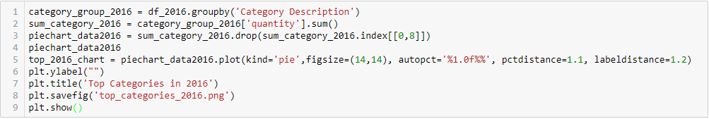
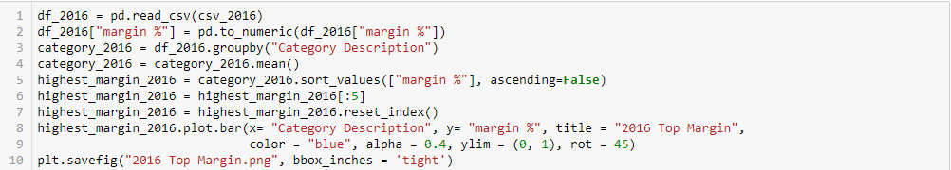
Codes used…
To sort categories/items by highest quantity sold and plot pie chart:
To sort categories/items by highest gross margin rate and plot bar graph:

Slide 11
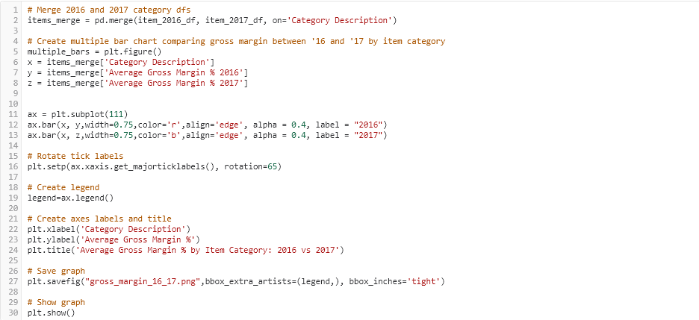
Codes used…
To sort categories/items by gross margin rate for 2016 and 2017, plot bar graph:

Slide 12
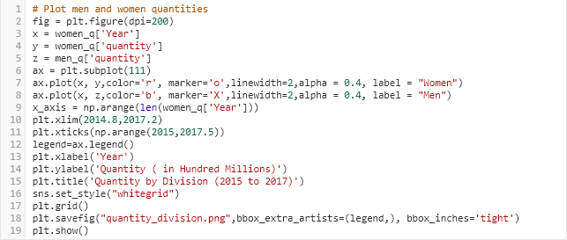
Codes used…
To sort categories/items by gross margin rate for 2016 and 2017, plot line graph:

Slide 13
The End
Q&A

